Slide 1
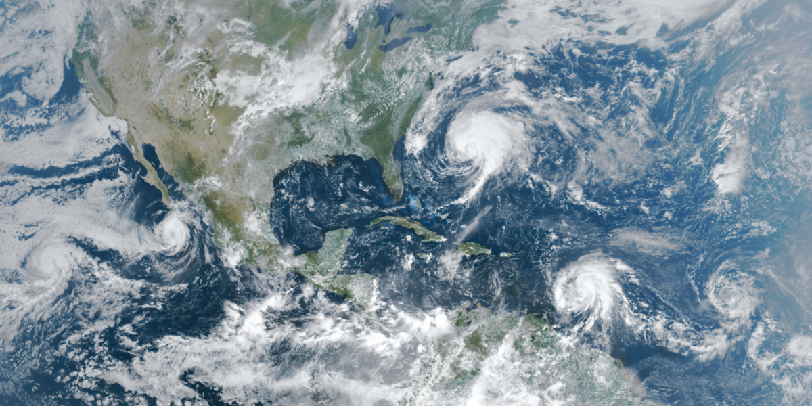
Global Weather Repository
Group 8:
Aiswarya
Neha Thakur
Saumya Varshney
Shikha Singh
Sreelekha

Slide 2
Introduction
Global Historical Climatology Network (GHCN) data from the National Oceanic and Atmospheric Administration (NOAA) website has been utilized for implementing the data pipeline.
In this project we are working on Cloud Analytics and Data Warehouse Implementation by building a data pipeline to analyze archival and real time weather data and gather useful insights from this data.
Temperature, Precipitation, Snow and Snow Depth patterns over the years will be analyzed and visualized for drawing useful insights which can be further utilized by industries.
Dataset link:
https://www.ncdc.noaa.gov/cdo-web/webservices/v2#gettingStarted
https://noaa-ghcn-pds.s3.amazonaws.com/index.html

Slide 3
Data Sources
NOAA GHCN-D AWS Bucket - This public bucket contains all the data collected by NOAA for the GHCN-D dataset from year 1750 to 2023. We are only considering the data from 2010 to 2023 for this project.
Each year is stored as a CSV, and the headers comprise of
station id - id for the weather station where the data was collected from.
date id - date at which the data was collected in the format yyyymmdd (20231130).
element id / datatype id - what category of data was recorded (maximum temperature, minimum temperature, precipitation, snow fall and snow depth).
Data / value - the data recorded corresponding to element.
Additionally, we scraped a lot of supplemental data from https://www.ncdc.noaa.gov/cdo-web/webservices/v2#gettingStarted using REST APIs.

Slide 4
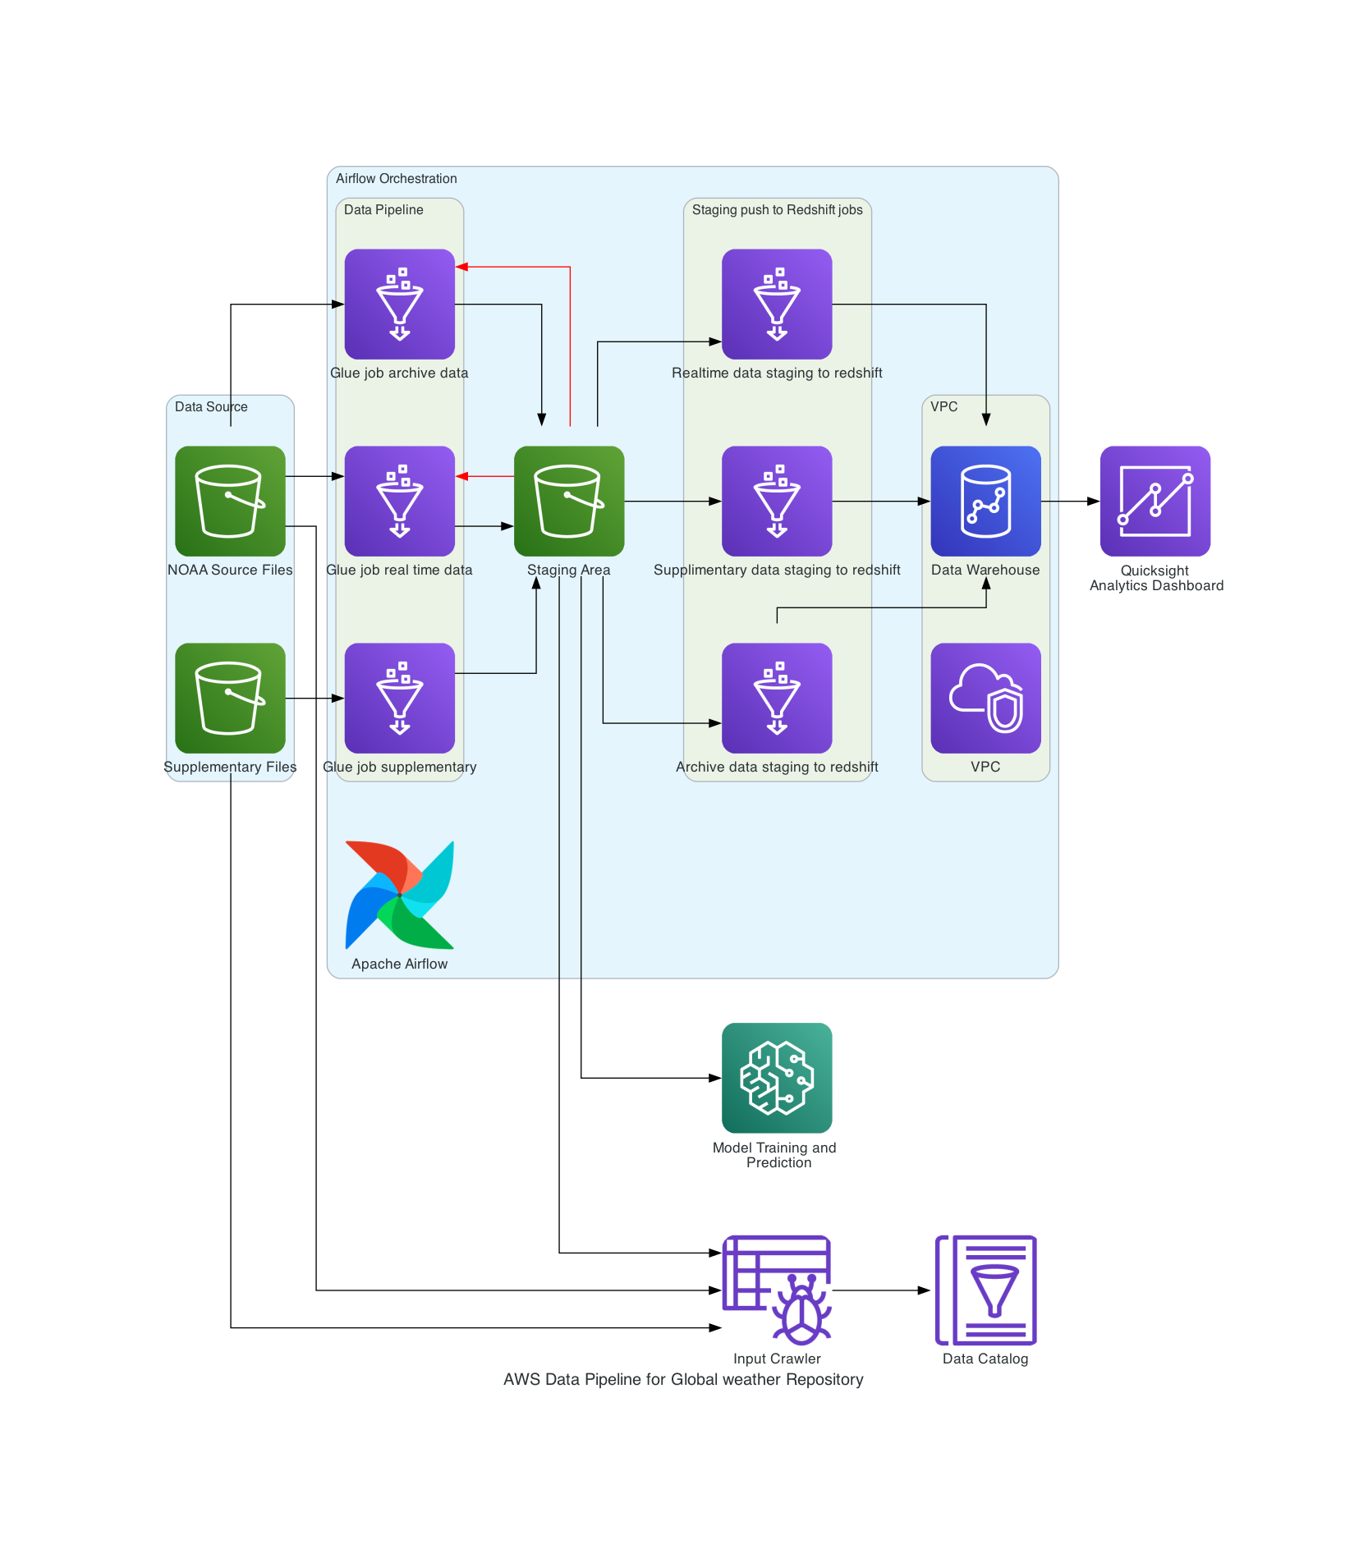
Cloud Architecture
AWS Services used:
VPC
S3
Glue
Glue Crawler
Glue Data Catalog
Redshift
Apache Airflow
Quick Sight
Sage Maker

Slide 5
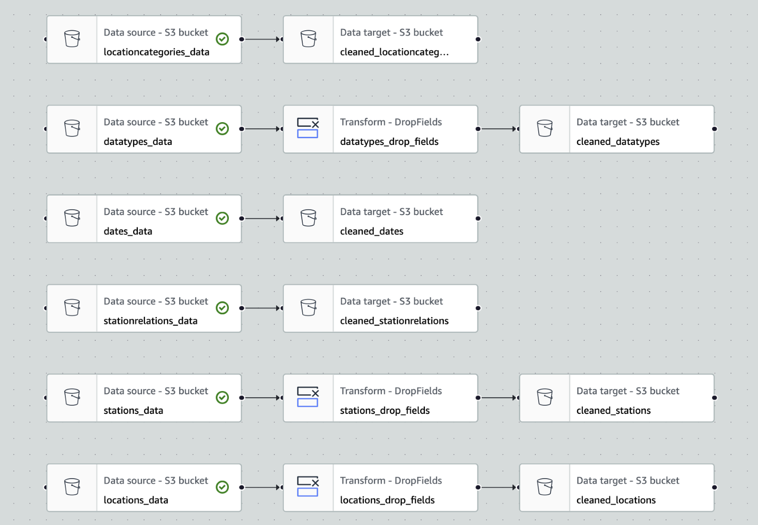
ETL (Extract-Transform-Load)
Supplementary Data Pipeline
Reads the raw CSV files from source S3 bucket, transforms and load the cleaned data to S3 staging area in parquet format.
locationcategories.csv
datatypes.csv
dates.csv
stationrelations.csv
stations.csv
locations.csv

Slide 6
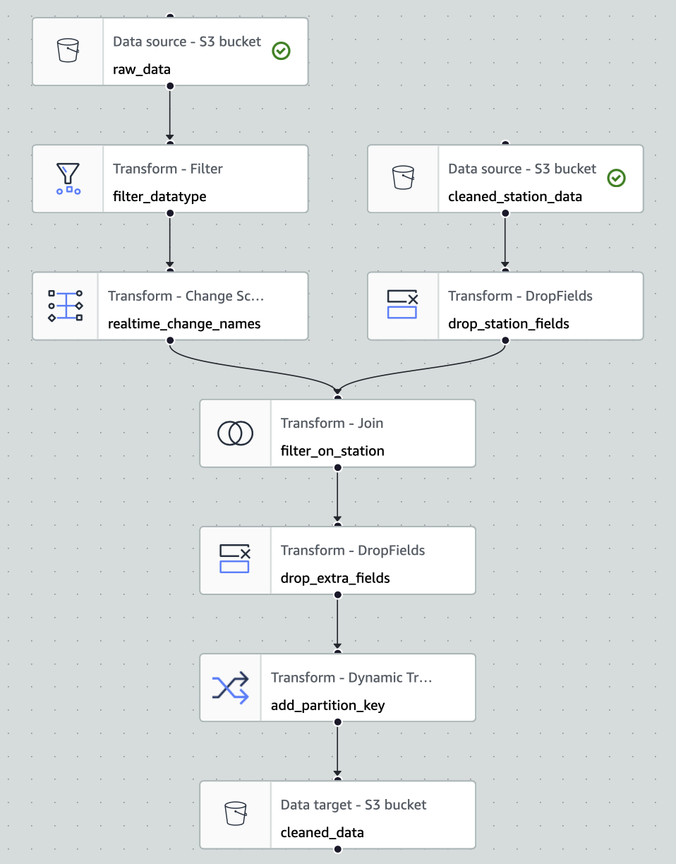
ETL (Extract-Transform-Load)
Archive (2010- 2022) and Real time (2023) Data Pipeline
Reads the raw CSV files from source S3 bucket, transforms and load the cleaned data to S3 staging area in parquet format.

Slide 7
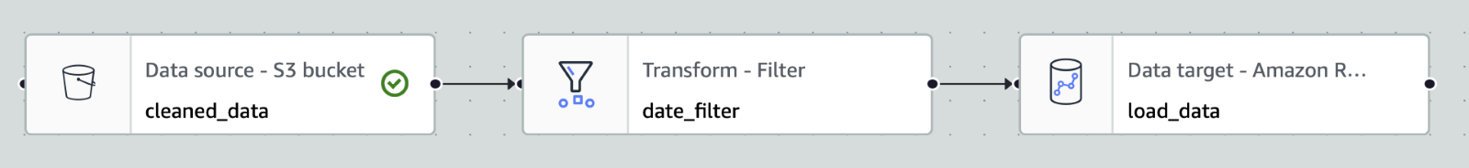
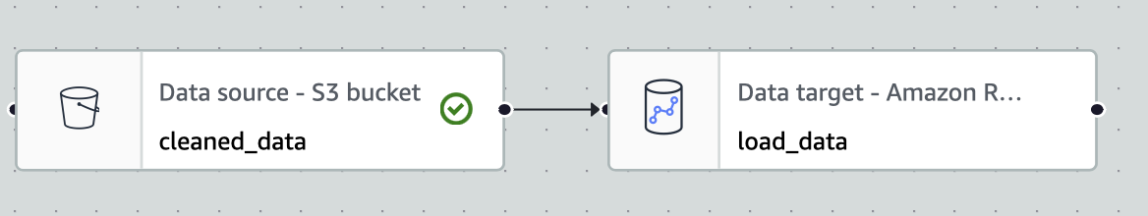
Load to Data Warehouse
Load Archive data to Datawarehouse
Load Real time data to Data Warehouse
Similarly, we have loaded supplementary data to data Warehouse

Slide 8

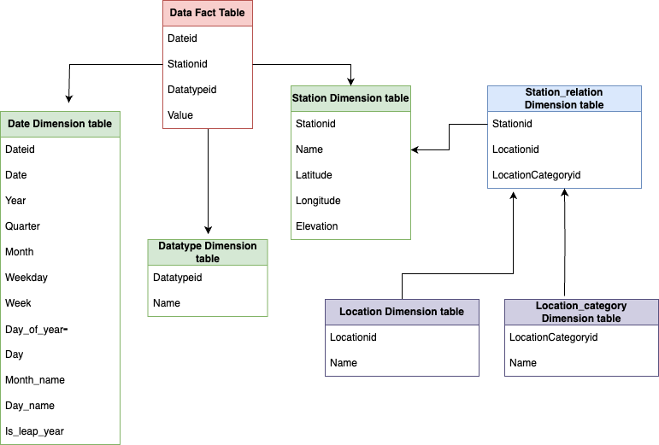
Data Warehouse Schema
Snowflake schema
Fact table – Data
Dimension table – Date, Datatype and Station

Slide 9
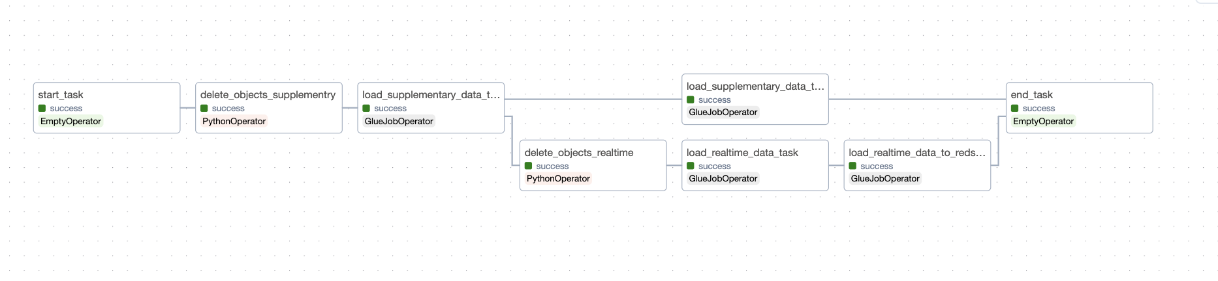
Apache Airflow
Real-time data pipeline

Slide 10
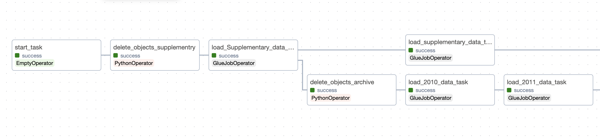
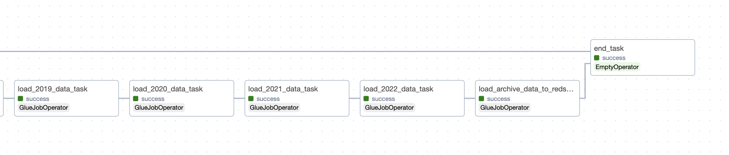
Apache Airflow
Archive data pipeline
-------
-------

Slide 11

Visualization
Analysis and Visualizations on Weather Parameters
Year wise Weather Analysis

Slide 12
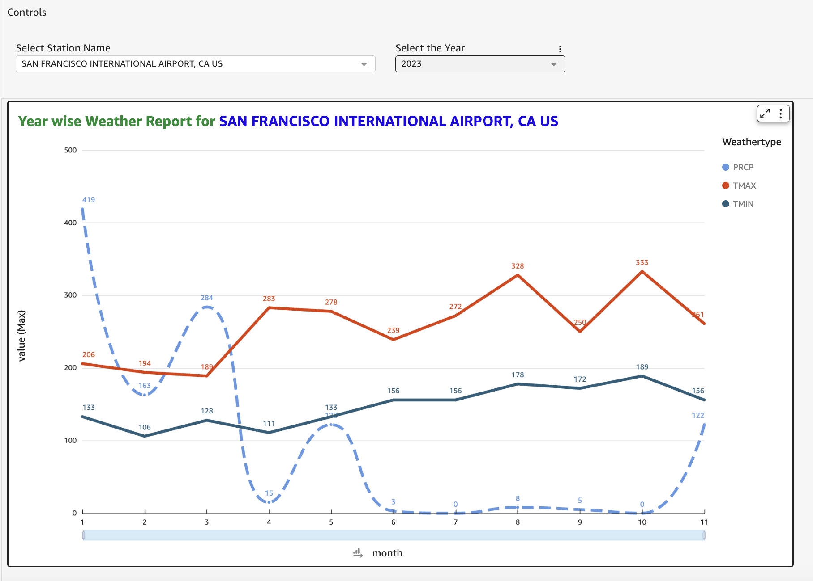
Visual Analysis

Slide 13
PREDICTIVE ANALYTICS
Prediction Model
We have used the XGBoost Algorithm to train regression model to predict maximum and minimum temperature, precipitation, snow fall and snow depth. We used this model as this is known to work best for tabular data.
Final Schema for Training Data Features
year | quarter | month | week | day_of_year | leap_year | latitude | longitude | elevation
Final Schema for Training Data Targets
TMAX | TMIN | PRCP | SNOW | SNWD
R2 score for your model is 0.398

Slide 14
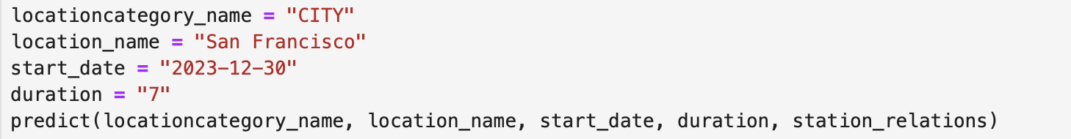
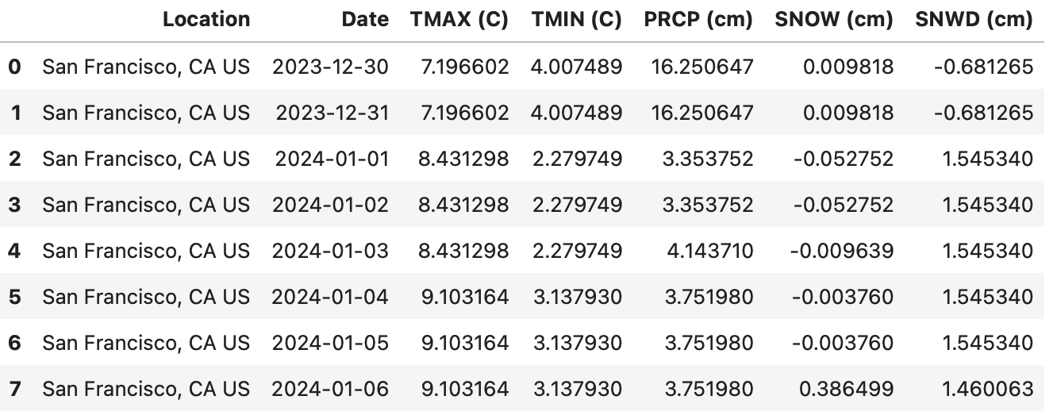
PREDICTIVE ANALYTICS

Slide 15
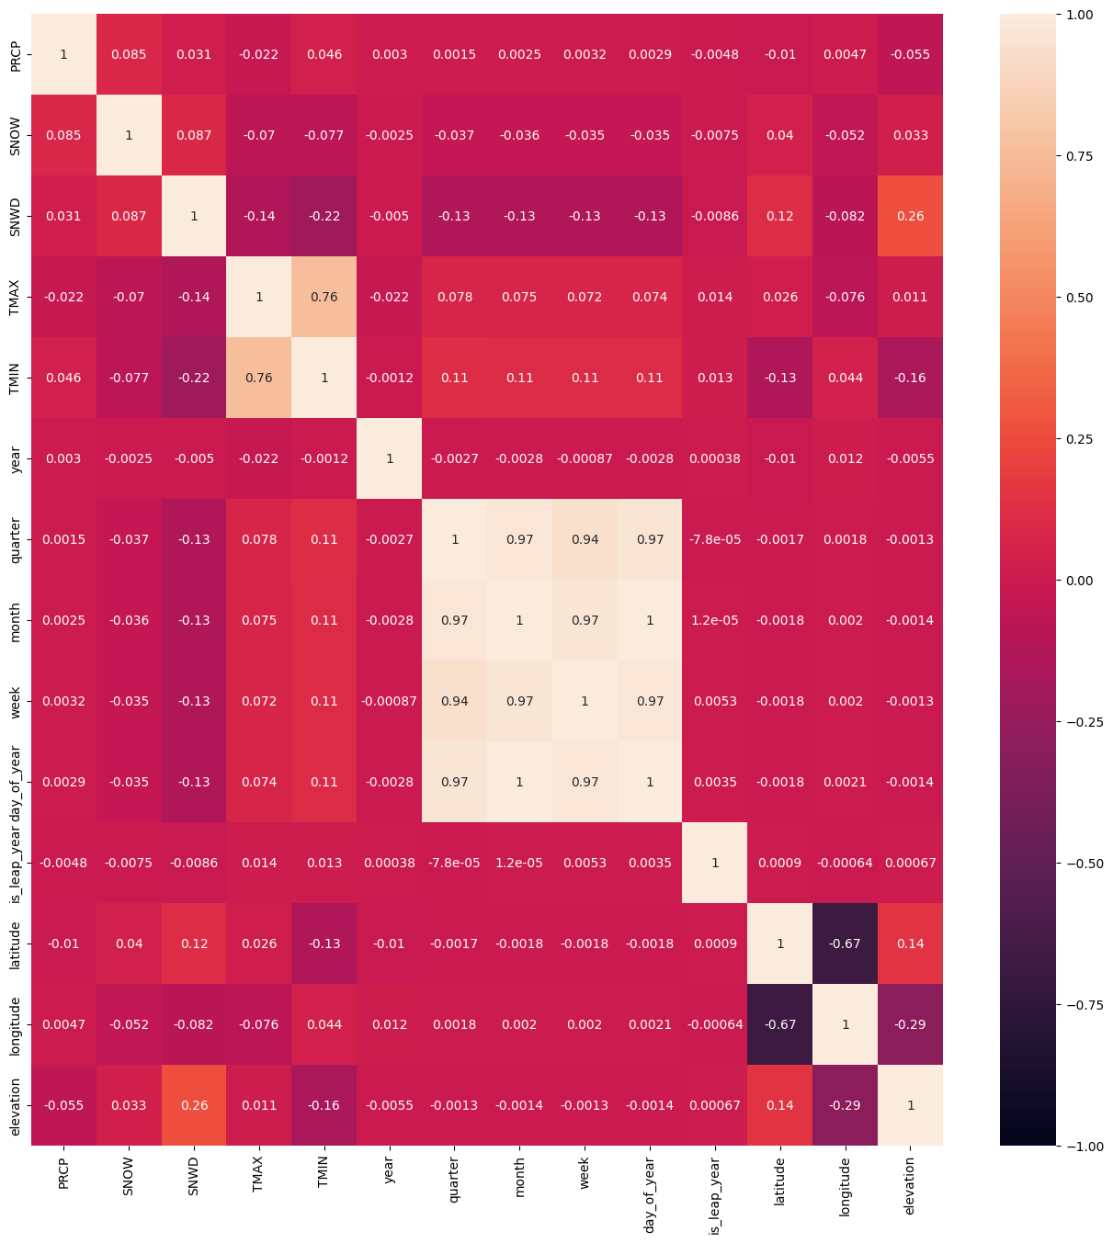
Correlation Analysis
We can see that there is a white patch in the center.
All those fields are highly positively correlated.
Latitude and Longitude are negatively correlated.

Slide 16
CONCLUSION
AWS powered system efficiently manages data from various sources, making it easy for businesses . We used tools like AWS Glue for pipelining, Redshift as data warehouse , Airflow to Orchestrate the pipeline and many more. Our data system on AWS helps companies organize information easily, make smarter decisions using advanced analysis, future predictions and stay flexible as their needs evolve. It's like having a reliable assistant that keeps everything in order and helps the business grow smarter.

Slide 17
Thank you

